Slide 1
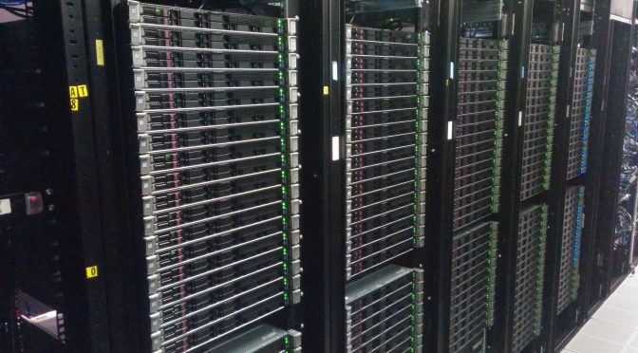
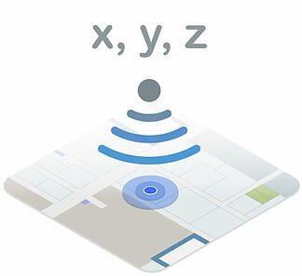

Distributed Deep Learning with DDL for Indoor Positioning on Huckleberry and Nano
weich97@vt.edu
jianyuan@vt.edu
Team 7: Weicheng Xue,
Jianyuan Yu

Slide 2
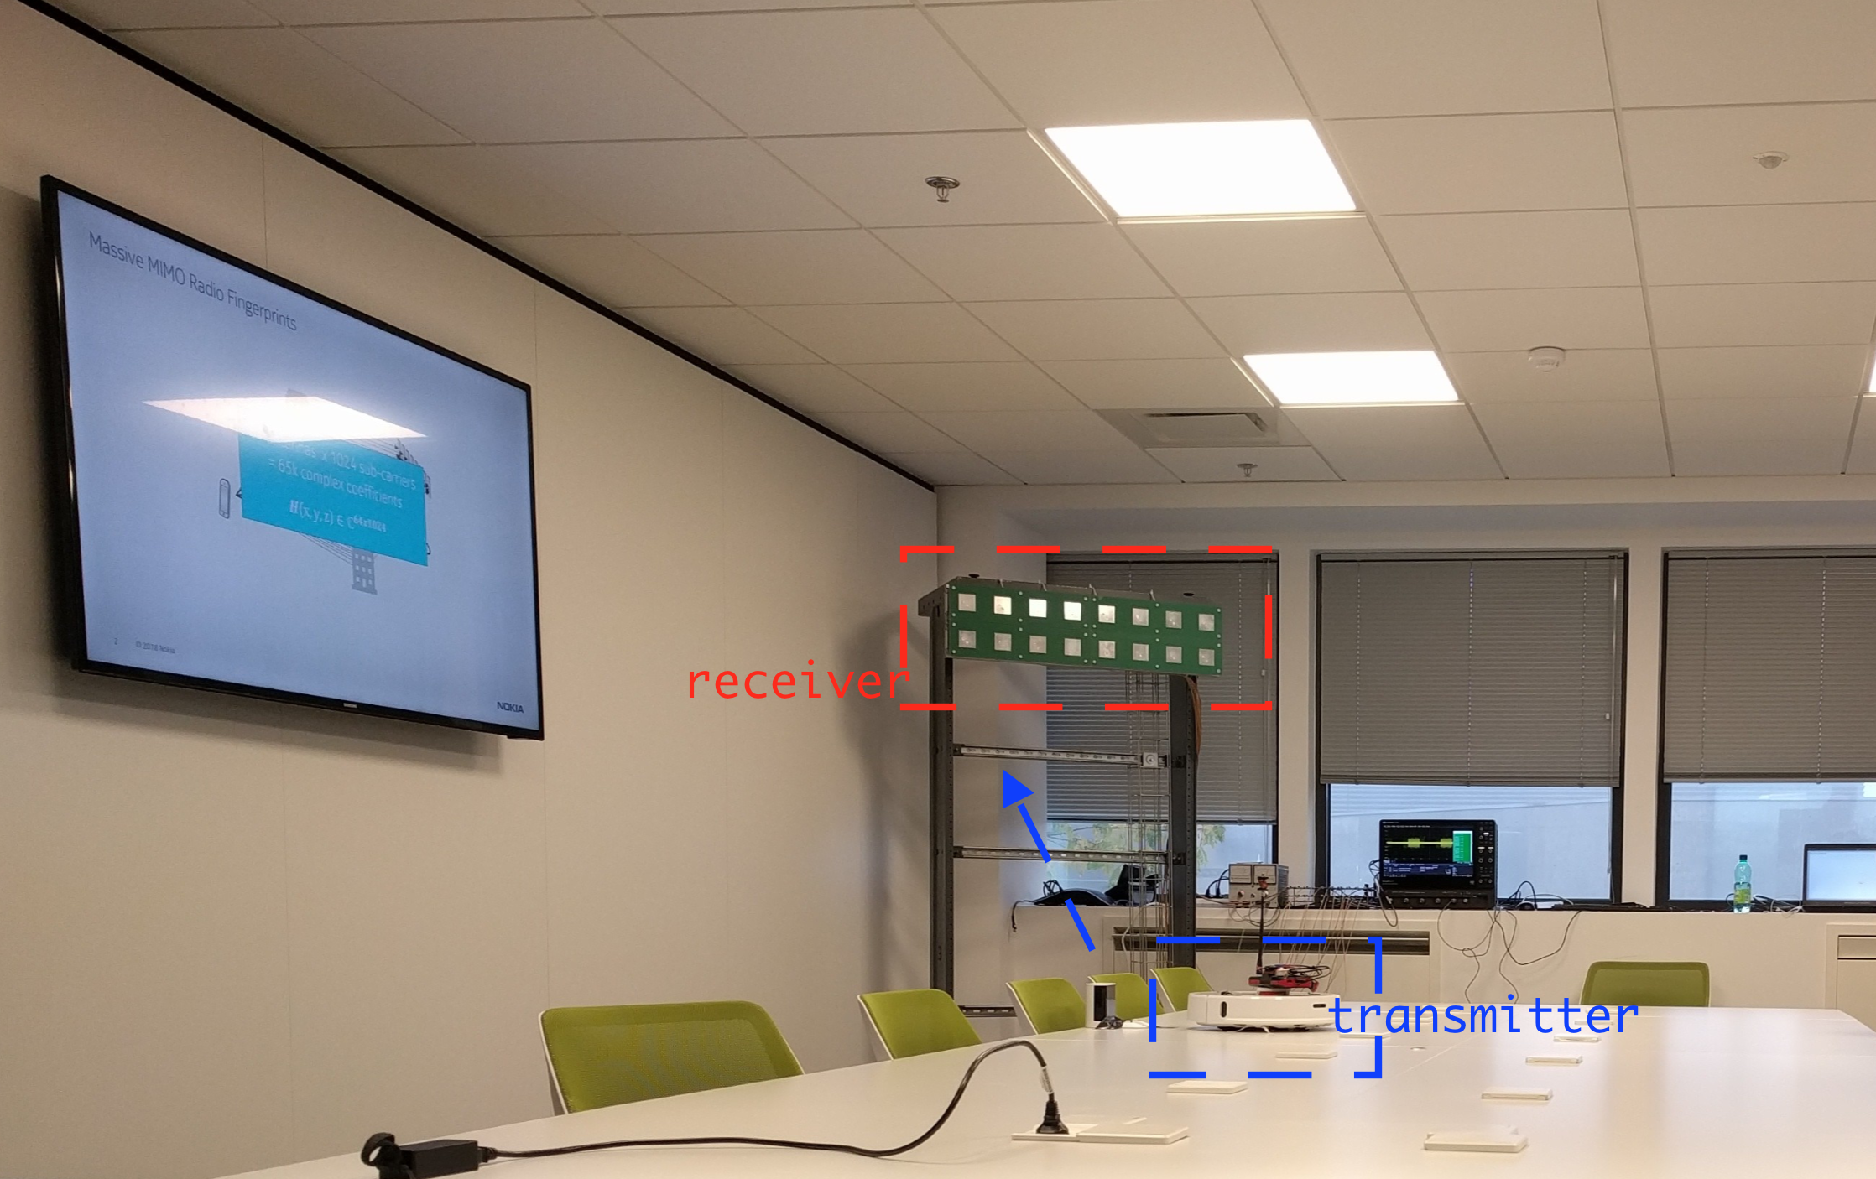
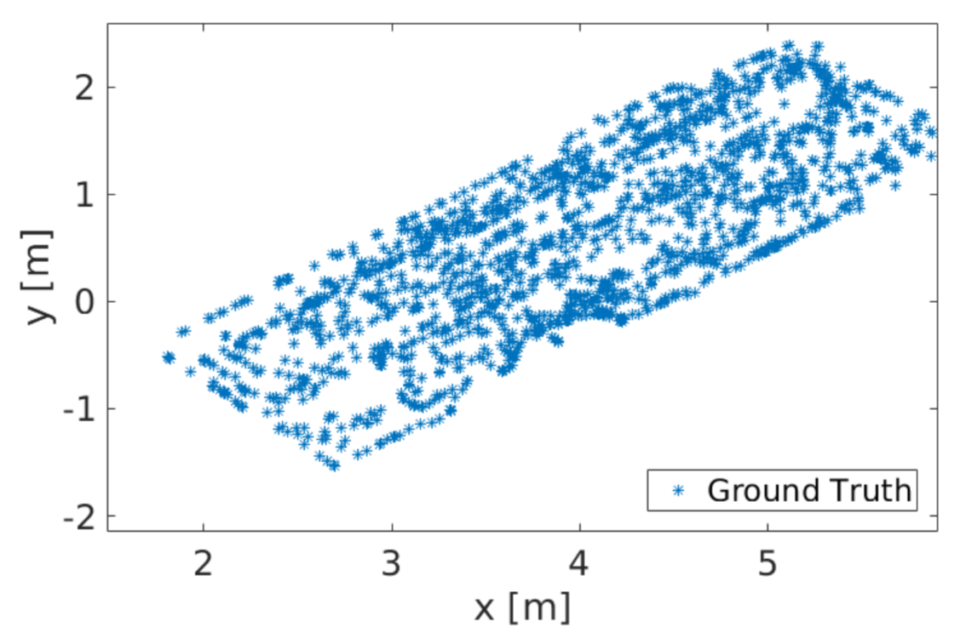
Background
Indoor positioning is a key to a wide range of app., e.g. navigation, smart factories & cities, surveillance, security, IoT, & sensor networks.
Goal: design and train an algorithm to determine the position of a random walk robot, based on received signals on antenna arrays.

Slide 3
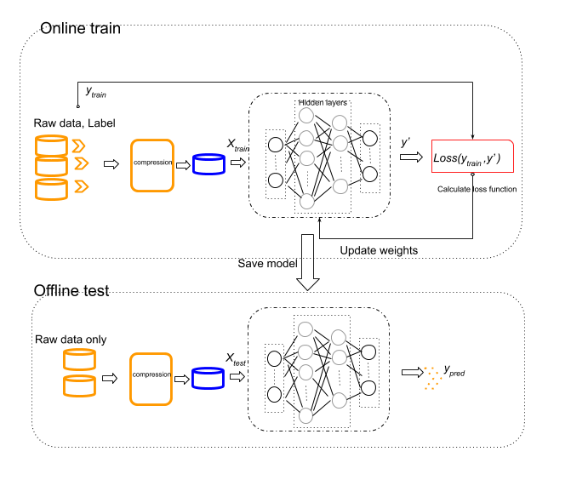
Methods
Data pre-process, covariance matrix Z = X * X’,
X of size 16*924, Z of size 16*16, highly compressed
Suppression noise and different modulation
Covariance matrix aggregated as input, to explore trajectory information,
Deep neural network implement, with hidden layer [512,256, 128], w/ techniques applied
Early stop
Batch normalization
Dropout

Slide 4
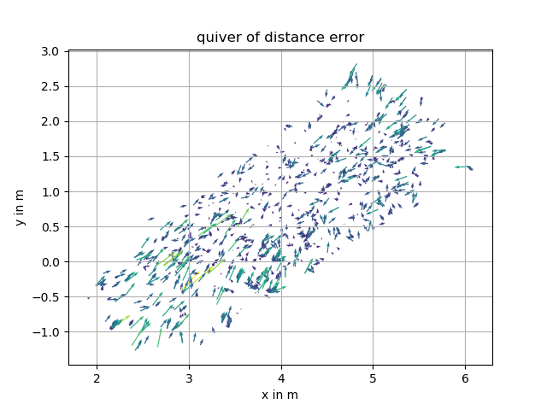
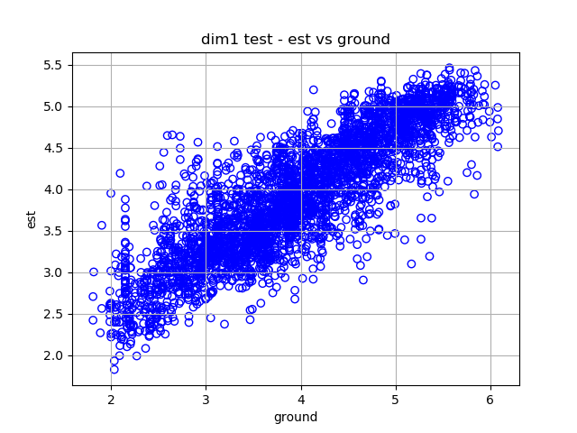
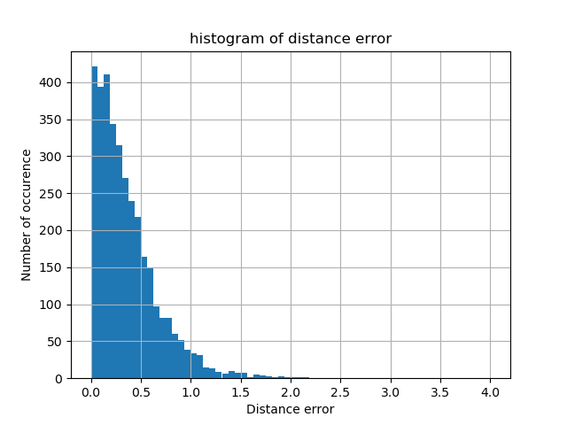
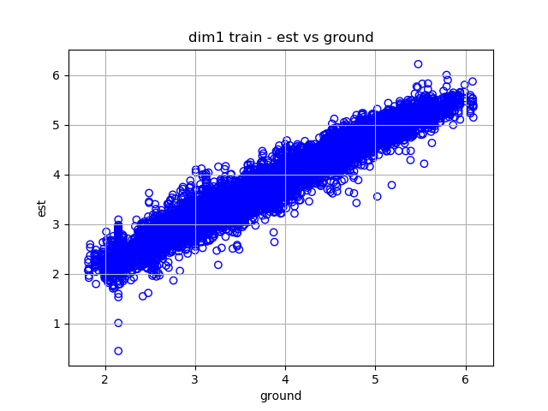
Performance Evaluation (1/2)
Fairly good estimation, error distance 0.62m, in a 5m * 8m room

Slide 5
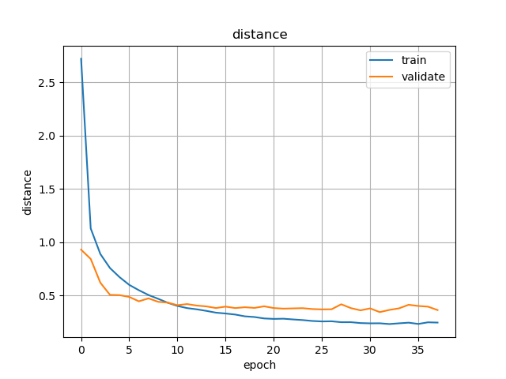
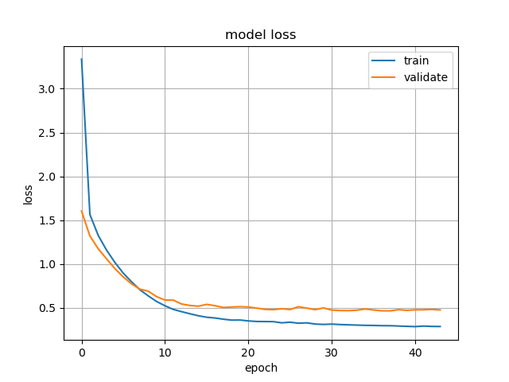
Performance Evaluation (1/2)

Slide 6
Acceleration & Parallelisms
Model Parallelism
Data Parallelism
(not our focus)
In-graph Replication
Distributed Training
Asynchronous Training
Synchronous Training
mean
gradients
gradients
DDL vs Tensorflow Distributed
Deploy to the edge
update
loss
loss
variables
model
model

Slide 7
What we have done
Do inference on Nano
Distributed Training
Asynchronous Training
Train on Huckleberry
mean
gradients
gradients
DDL vs Tensorflow Distributed
Deploy to the edge
update
loss
loss
variables
model
model

Slide 8
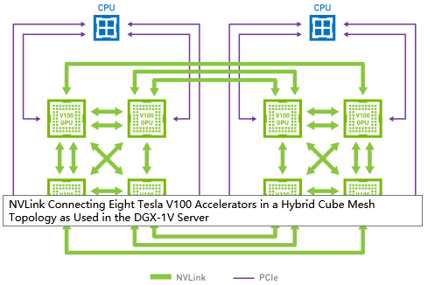
NVLink on Huckleberry
https://www.nvidia.com/en-us/data-center/nvlink/

Slide 9
TensorRT on Nano
C++ library for high performance inference
Prerequisites
- Although TensorRT has been installed, it requires several python packages to
be installed
Steps
- Create a TensorRT network: import the model using the TensorRT
parser
- Build an engine and perform interference: tensorRT can optimize the
network and accelerate the inference
- Store the engine for later use

Slide 10
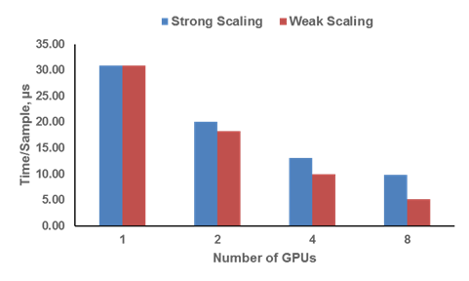
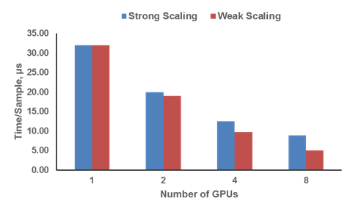
Training on Huckleberry
Different Data sizes
The Lower the better
Data size: Left, 5 k; Right, 10 k
In node: <= 4GPUs; Across node: 8 GPUs
Strong scaling efficiency: ~ 40% at 8 GPUs;
Weak scaling efficiency: ~80% at 8 GPUs

Slide 11
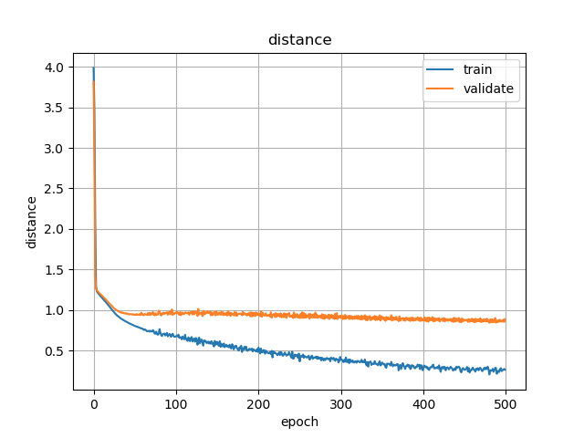
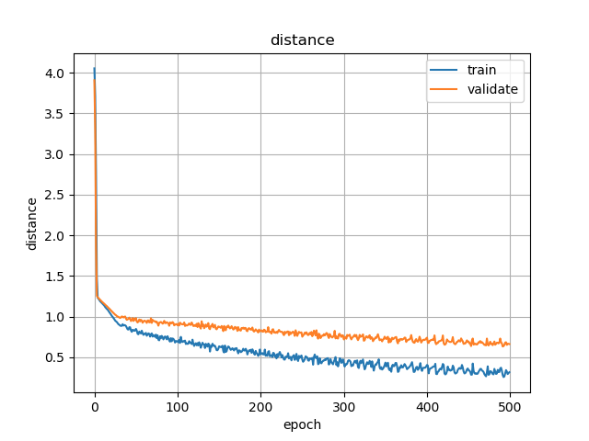
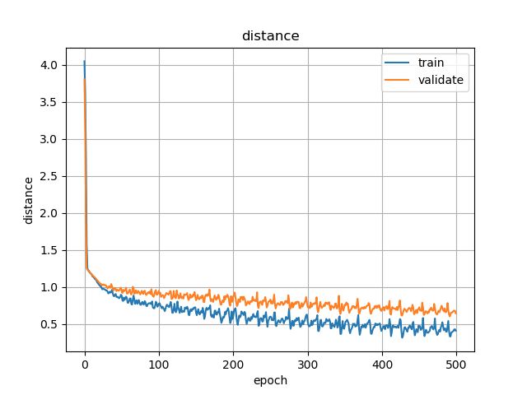
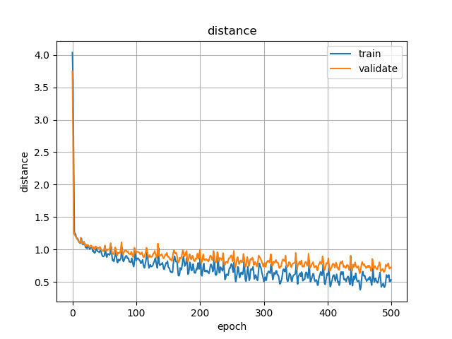
Training History
Multi-GPU on the 10 k dataset
1 GPU
2 GPUs
Multi-GPU achieves same level accuracy, although with some oscillations
Multi-GPU even converges a little faster
Multi-GPU is faster (gain
speedup)
4 GPUs
8 GPUs

Slide 12
Deploy to the Nano
Error Norm on Test Dataset
# of GPUs | 1 | 2 | 4 | 8
Direct Evaluation on Power | 1.0136433829 | 1.1880179926 | 1.16150990851 | 1.2219653829
Applying TensorRT on Nano | 1.0136433762 | 1.1880179681 | 1.16150990049 | 1.2219653452
Errors evaluated directly on Power and computed applying TensorRT on Nano are pretty close (Single Precision)
TensorRT just requires cudnn (not available) to work on Huckleberry

Slide 13
More thoughts
“Truely” Heterogeneous Training
- Training on CPUs and GPUs
- Make full use of compute capabilities, otherwise may waste resources
- High requirement for communication and latency
Portability
- Port the code to other end devices
Thank you, any questions?

Slide 14
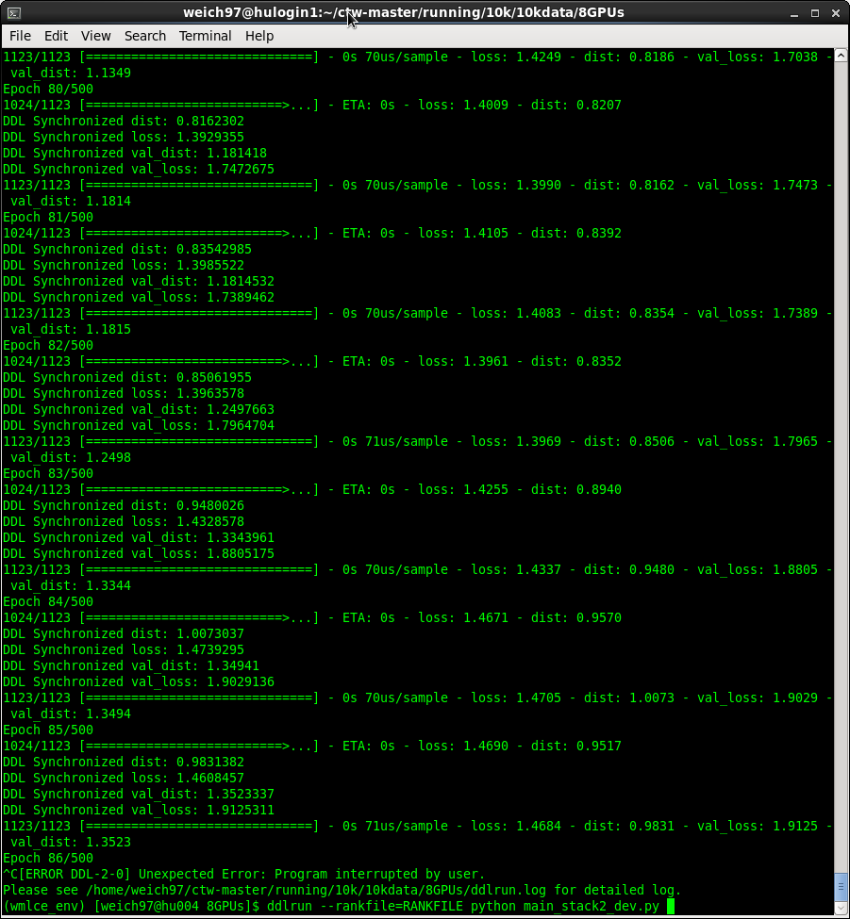
Appendix
Distributed Training on Huckleberry (8 GPUs)

Slide 15
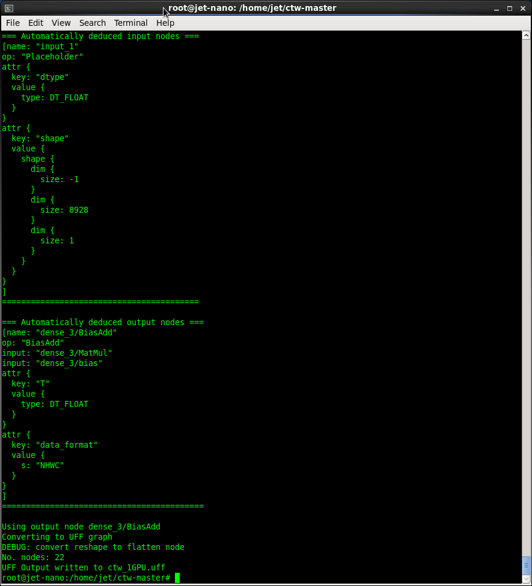
Appendix
Converting pb file to uff file

Slide 16
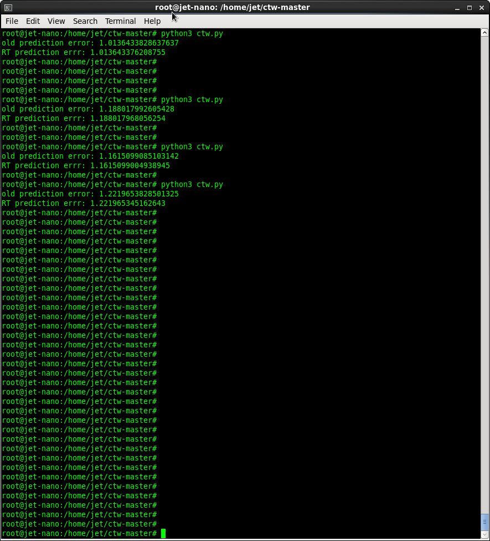
Appendix
Inference on Nano

